Slide 1


Slide 2
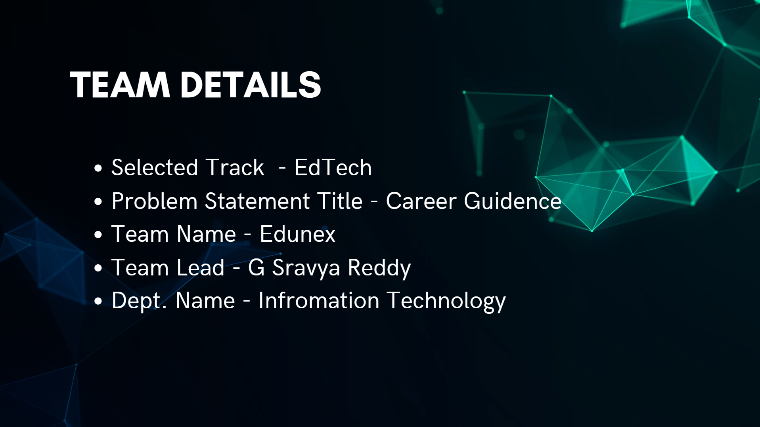

Slide 3
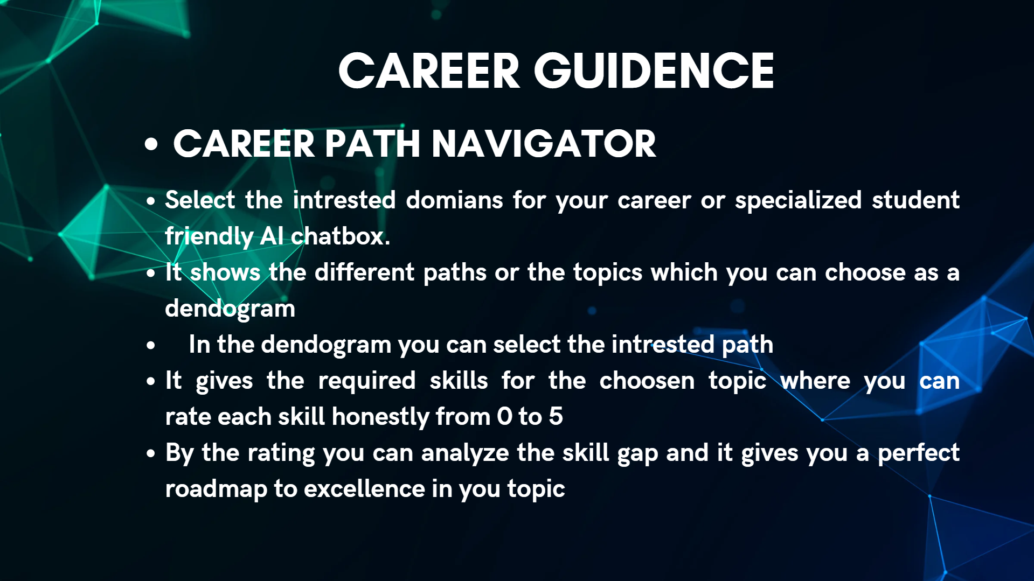

Slide 4
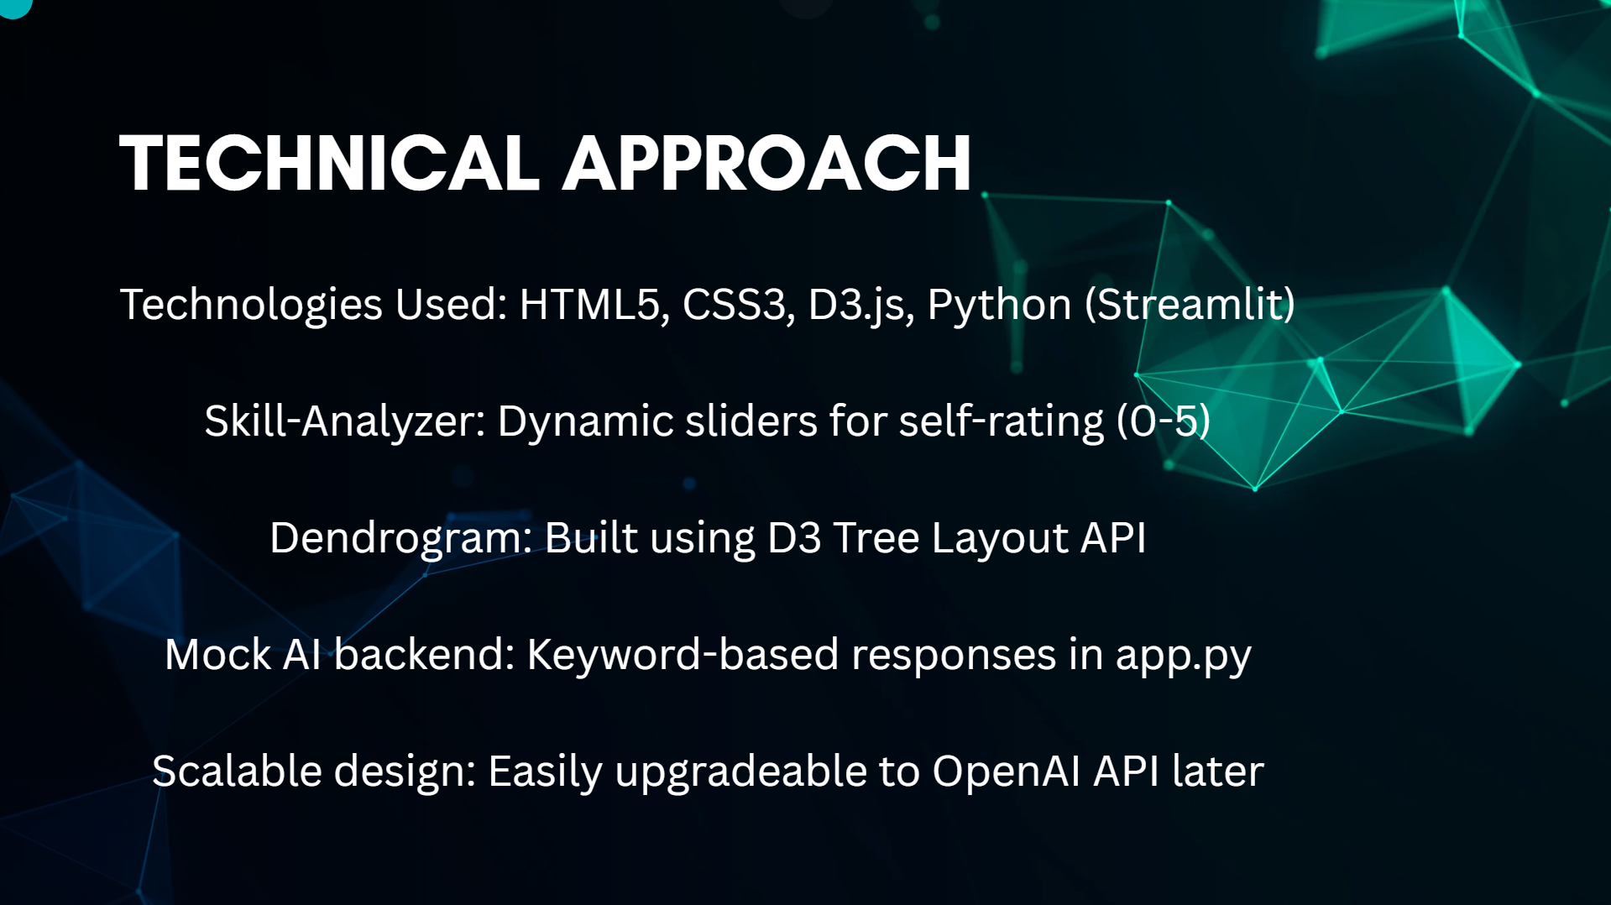

Slide 5
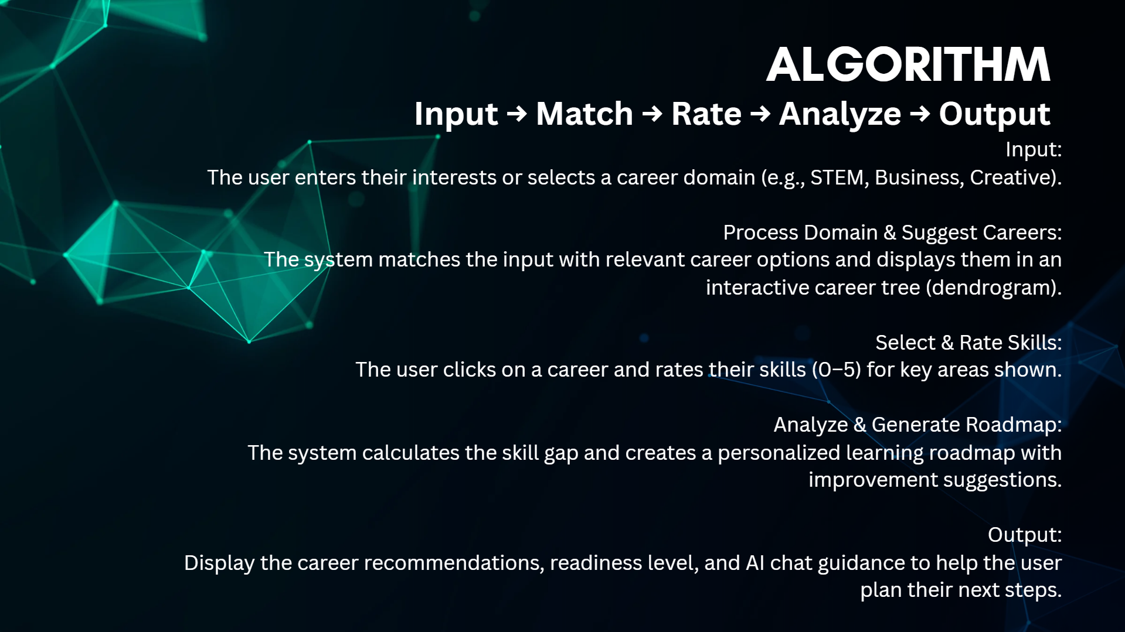

Slide 6
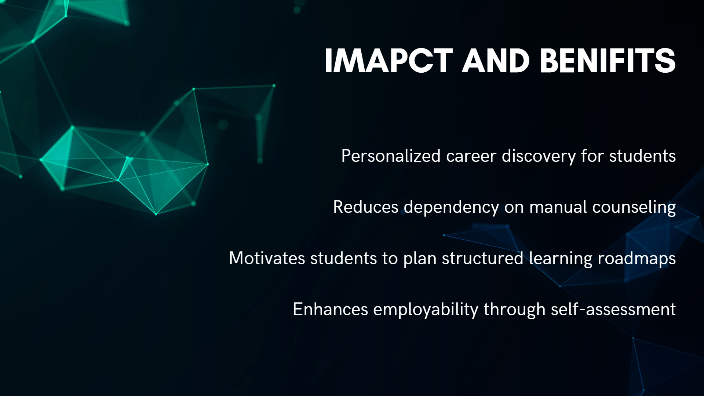

Slide 7

RESULTS-
Github Link-
https://github.com/sravyagundedi/career-path-navigator.git
Deployment Link –
https://career-path-navigator-ocrfxwkvjtvozu3pfk9v8k.streamlit.app/

Slide 8
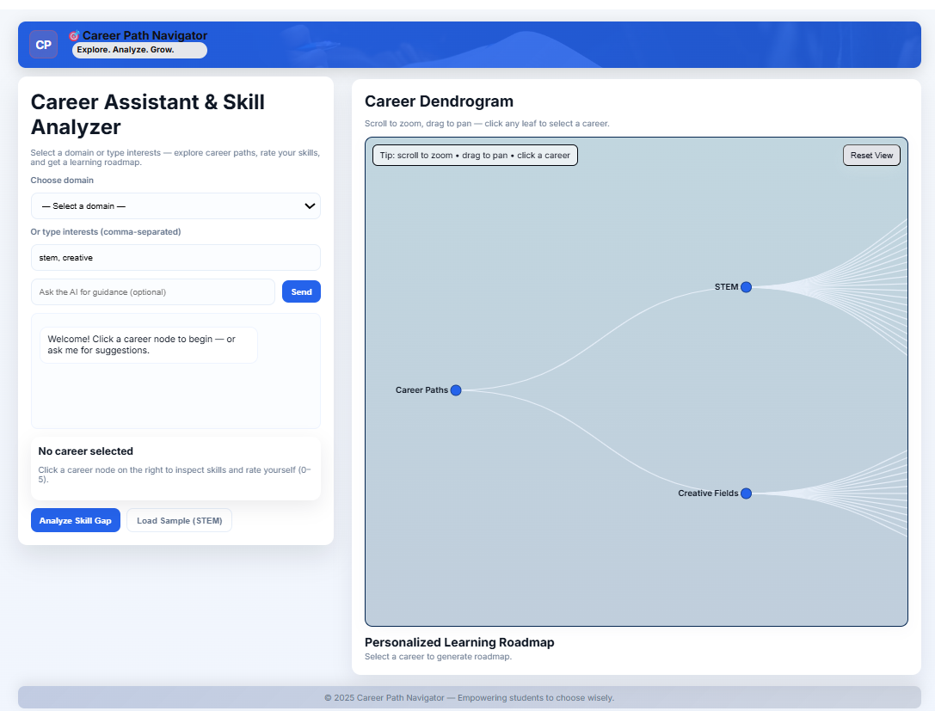

Slide 9
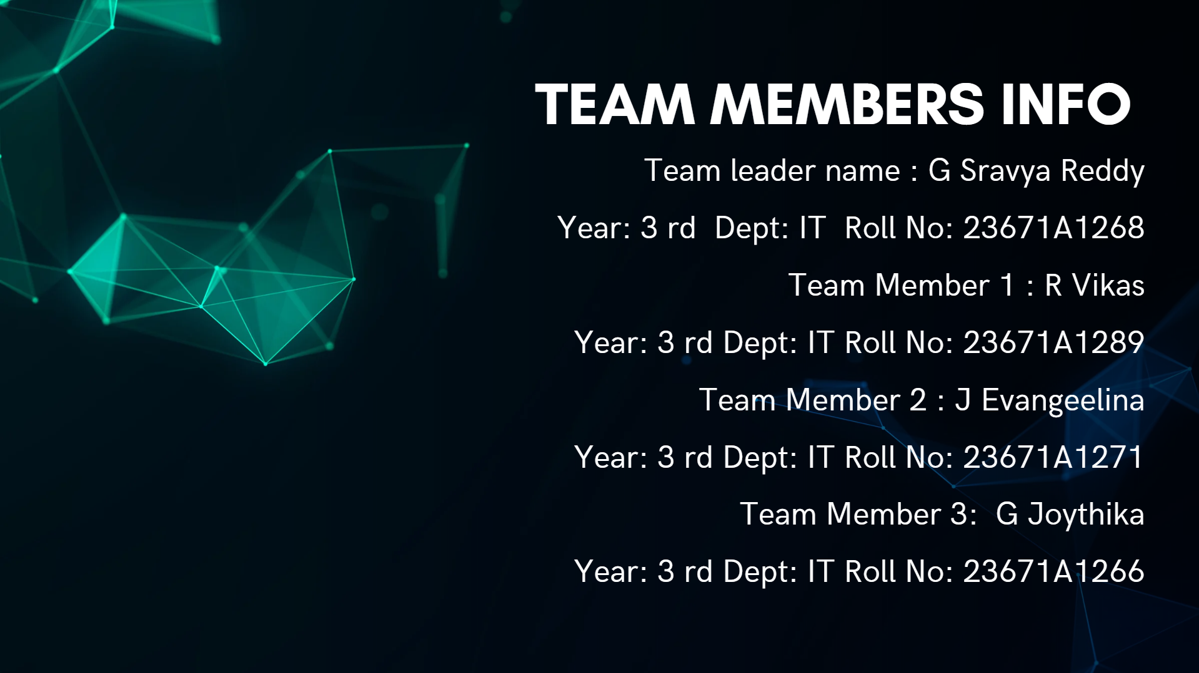

Slide 10


